Slide 1
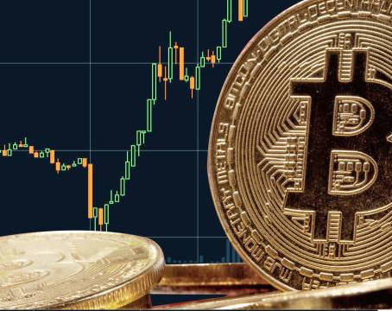
NFT Workshop
Bali Bitcoin Meetup Marvin F. L. Hansen
Notes:
Link to download slides: https://ufile.io/mnkta

Slide 2

MISSION
Mission: “Help you to succeed financially!”
Goals:
Strengthen understanding of finances!
Practical application!
Smart investment!

Slide 3
Overview
Money:
Fiat Money Problem
Part I: Financial Markets:
Intro financial markets & cycles
Buy/Hold vs. Swing Trading
Technical Analysis
Part II: Crypto Investment (Manau)
How he beats the market
Strategy break down

Slide 4
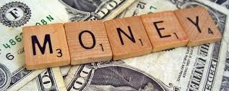

Slide 5
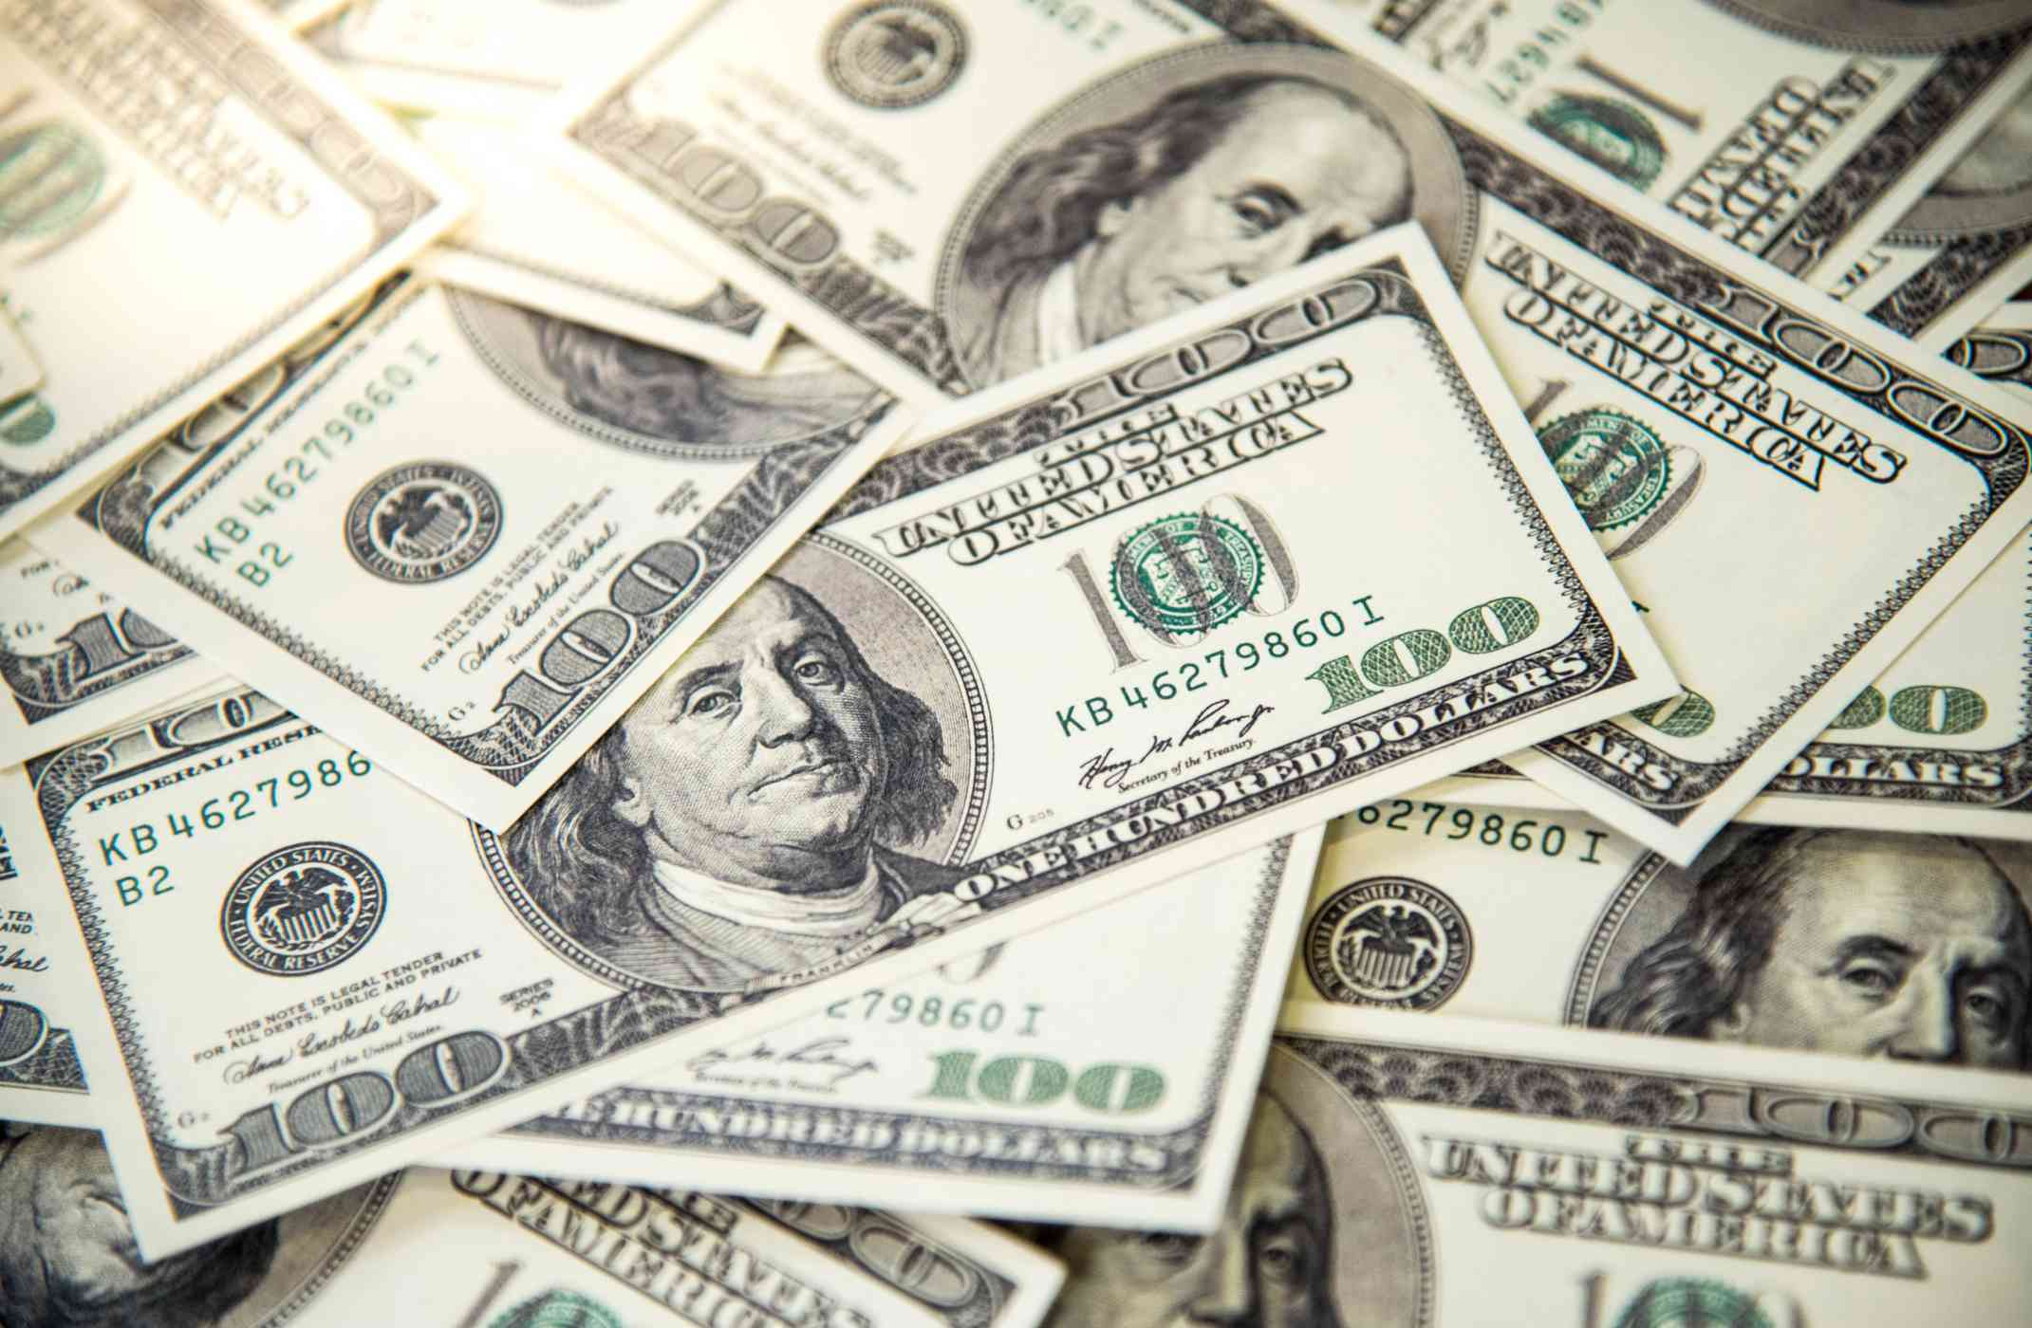
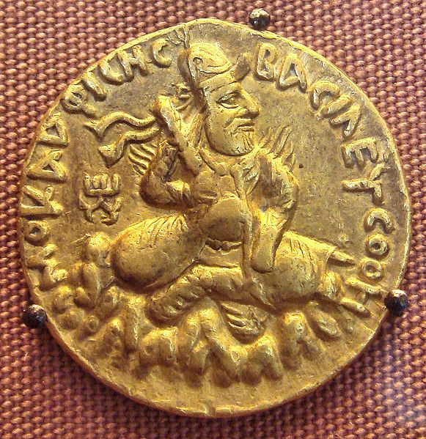
Two kinds of money
Commodity Money
Fiat Money
Money whose value comes from a commodity of which it is made!
Intrinsic value
Rare: hard to mine, or very difficult to acquire
Worth what people agree to pay!
Examples:
Gold coins
Rare spices
Silk, Jade etc.
Money created by Government through a legal degree
Zero intrinsic value
Gov. just prints it as needed
Worth what people believe its worth measured by the economic strength of the issuing country
Notes:
https://www.powercoin.it/en/cit-coin-invest-ag/5439-inca-sun-god-1-oz-silver-coin-5-palau-2021.html?gclid=EAIaIQobChMIkYexucK28AIVjhBgCh1UIAH-EAQYAyABEgIz1_D_BwE

Slide 6
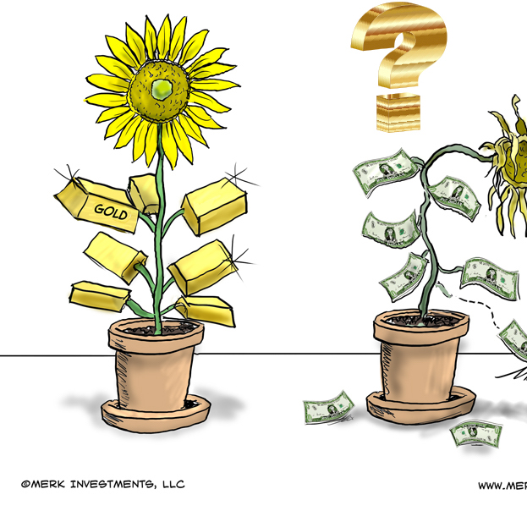
Fiat Money Problem
Printing too much money makes less valuable (inflation)
Not backed by anything else than public trust in the Government. Brexit & GBP....
Foreign Exchange Rates (Forex) swing widely during turmoil. Turkey & Lira…
Cash a lot less valuable than Gold!
Notes:
https://forum.vite.net/topic/2677/3-fiat-currencies-that-were-more-volatile-than-bitcoin-in-2019

Slide 7
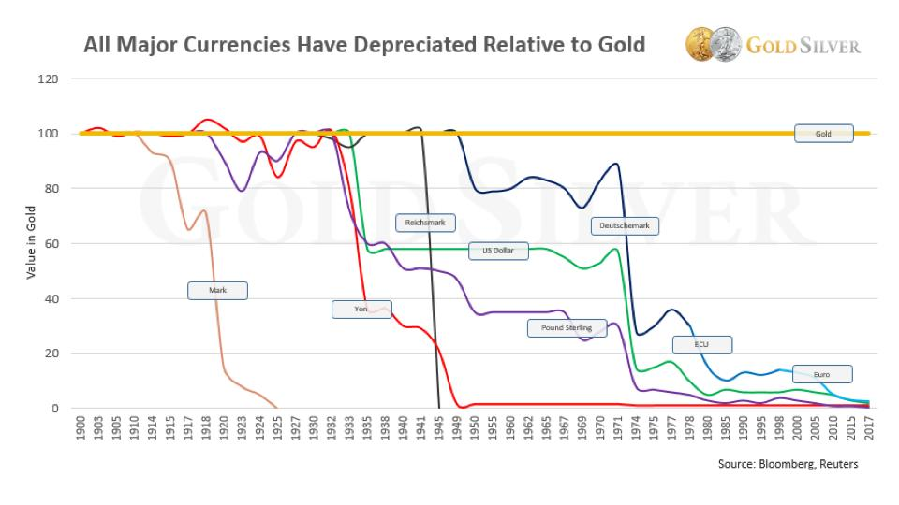
Notes:
https://www.gold-eagle.com/article/will-gold-replace-us-dollar-2020

Slide 8
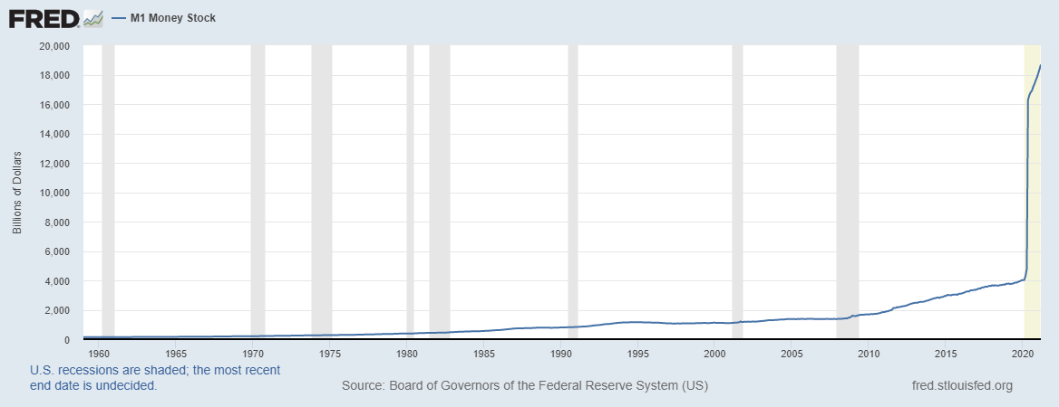
…. 12 TRILLION More $ in 2020!
Notes:
Let’s zoom in

Slide 9


Notes:
https://twitter.com/goldtelegraph_/status/986715688717901824

Slide 10
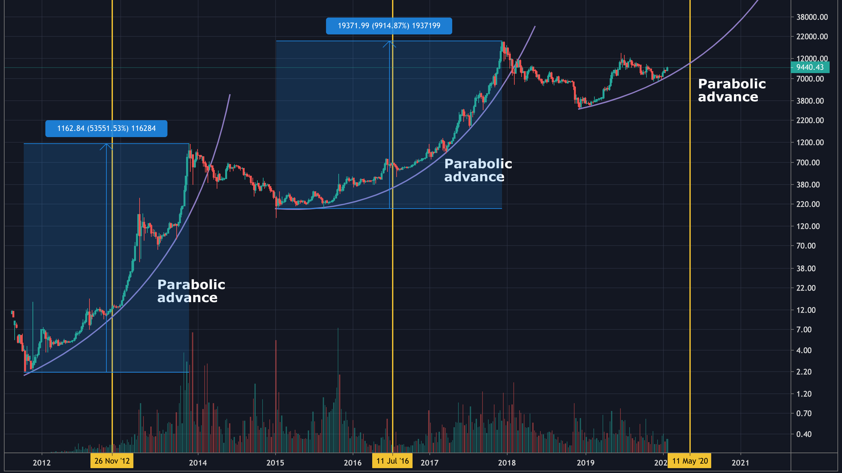

Slide 11

Summary
More money printed than ever in the history of mankind
Money loses more and more value
No saving possible because interest rates are about zero
The Fed, essentially, destroys the value of your hard-earned cash!
BTC acts more of a value store akin to GOLD but also increases in value due to decreasing supply

Slide 12

Part I: Financial Markets

Slide 13
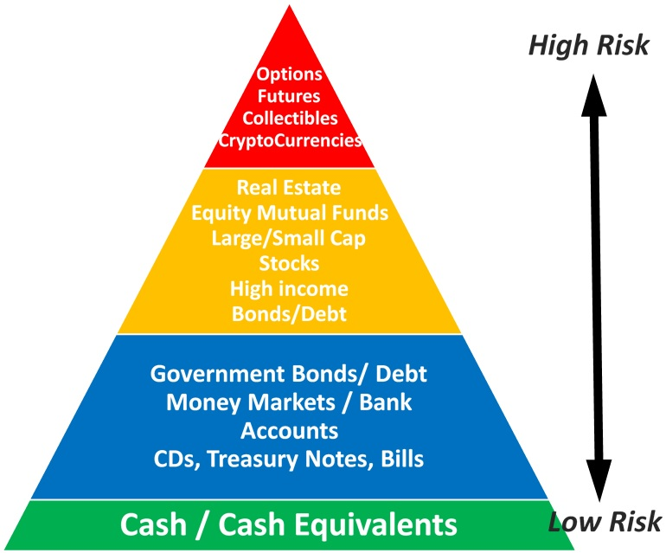
Risk category per asset class

Slide 14
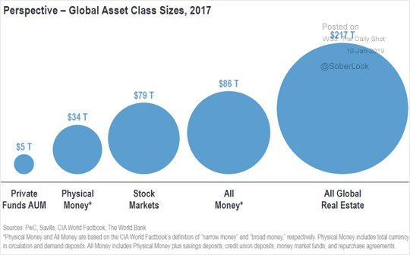
Asset Class by size

Slide 15
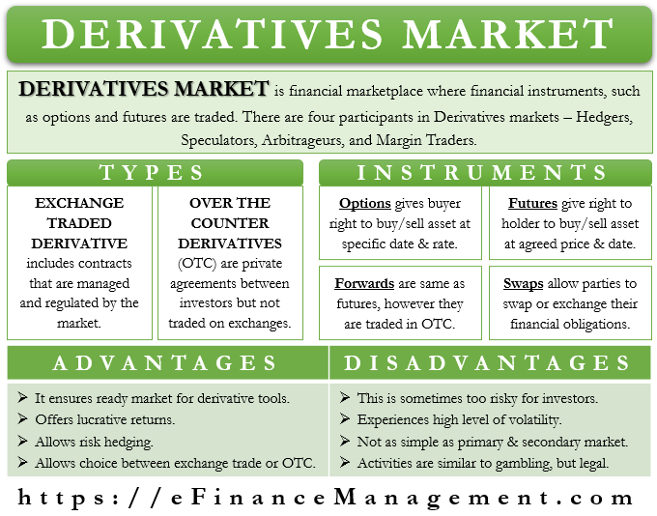
Derivatives…

Slide 16
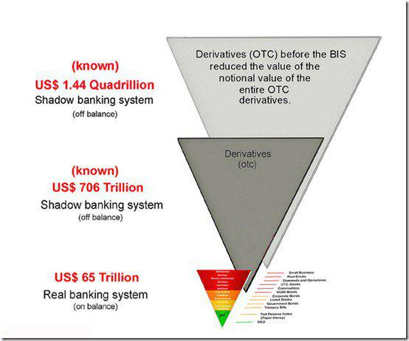
Derivative market size

Slide 17

Wait, what?
We only have $80 t. in global cash but we have some $ 1.4 quadrillion(!) structured derivatives
How can it be that the highest risk class (derivatives) contributes the largest share of all financial instruments?
Because any derivative allows asset exposure through a claim on that asset at a much lower cost and without actually owning that asset
Essentially, you trade an uncertain risk outside of your control for a risk within your control(!)
Risk swapping is at the core of a 1.4 Quadrillion $ market!

Slide 18
Risk paradox
Paradox: Derivatives only create the illusion of control, but instead of containing the risk, these actually increase the exposure to the very same risk(!)
Why would you do that?
Pre-financed stock purchase
Hedging
B) Securitization

Slide 19
Pre-financed stock purchase
Quota: You $100k to invest in the stock market
Thesis: You estimate that the S&P stock index, currently at $4200, would resume going up for one more quarter.
Plan:
You estimate that the index will climb to, say, $4500
You buy 238 SPY shares (438*420 ~100k)
You set the stop loss order at $390 ~ 4.5% loss
You set the profit taker order at $450 to aim for ~7% return
Consideration: How to lower total acquisition cost?
You sell three puts at a 410
You collect 3 * $1200 = $3600
Now you get 8 SPY shares for free, increasing you position to 446 for the same 100K!

Slide 20
Hedging
Consideration: What if things go the other way?
Hedging:
You buy 3 Put options at 450 strike to protect your portfolio
To refinance your hedge, you sell 3 puts at 440 strike
Cost of hedging: 2*($3500– $2500) = $2000
If the market goes up, all puts expires worthless (total loss)
If the market goes down, the put makes money equal to 200 shares and offsets losses from the 238 you are holding
Delta neutral: No matter where the market goes, you make money!

Slide 21
Securitization
Observation:
Say you own 238 SPY shares
The market is going up, so your hedge is written off as a full loss
Exit preparation:
Now, you write 2 Calls at $465 and collection 2*$220 = $440
If the market reaches $465, you sell 200 shares for $465 each
If the market stops before, the calls expire and you keep the $440
Exit:
The market stops at $453
You sold 246 shares at $450 = $ 13380 gain
You paid hedging fees of = $2000
You recouped $440
Total: $ 11820 (11% in a Quarter)
Notes:
13380 – 2000 + 440
SPY Option chain
https://www.nasdaq.com/market-activity/funds-and-etfs/spy/option-chain

Slide 22
Conclusion
Plain hedging expensive at scale
Pre-financed stock purchase, however, offsets hedging expenses
Securitization helps you to offset some more of the expenses
However, requires sophisticated market and risk assessment
That’s exactly how Warren Buffet invests ;-)
Notes:
13380 – 2000 + 440
SPY Option chain
https://www.nasdaq.com/market-activity/funds-and-etfs/spy/option-chain

Slide 23
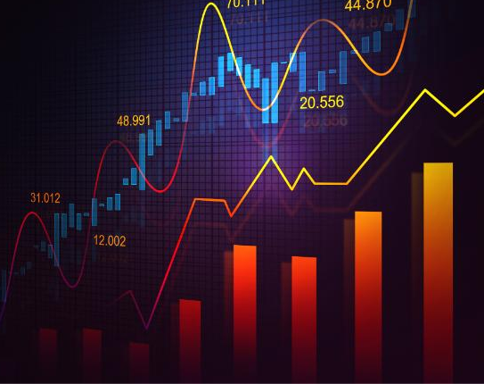
Buy/Hold vs. Swing Trading

Slide 24
Trading plan
Before you buy anything, you make a trading plan
Determine key market levels & pivots or patterns
Support & Resistance, Fibonacci’s etc.
Day / Week / Month high low
Candlestick patterns, chart patterns etc.
Estimate market direction and magnitude
Set entry target
Set exit target
Stop loss (SL) target
Profit taker (PT) target, that is, a notch below exit target
Open position with SL & PT attached as brackets
Realistic expectation: The plan works out > 65% of the time. If less, you need a better plan! If more, great!
Notes:
PT is set a notch below exit:
Often, exit points overlap with major pivots or retracement points
Running stops may occur before you close
Thus you close a notch below, loose a penny, and safe the farm by exiting before the running stops

Slide 25
BUY / HOLD
Buy / Hold was the idea of the previous example
You place any trade with attached GTC bracket orders covering stop loss and profit takers
Then you hold on until
The stop loss was hit and position auto-closes
The profit taker was hit and position auto-closes
You have new evidence that warrants an out-of-plan closure.

Slide 26
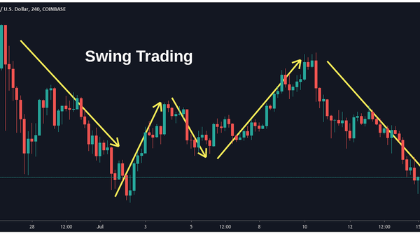
Swing Trading
You trade actively market up’s & down’s
Long trade: Buy low and sell high
Short trade: Sell high and buy back low
Either way, the idea is to pocket the difference between price swings
Challenge:
Detecting & timing swings
Position sizing a.k.a. reduce loss
Risk management a.k.a. reduce loss
Can’t really hedge during intraday swings

Slide 27
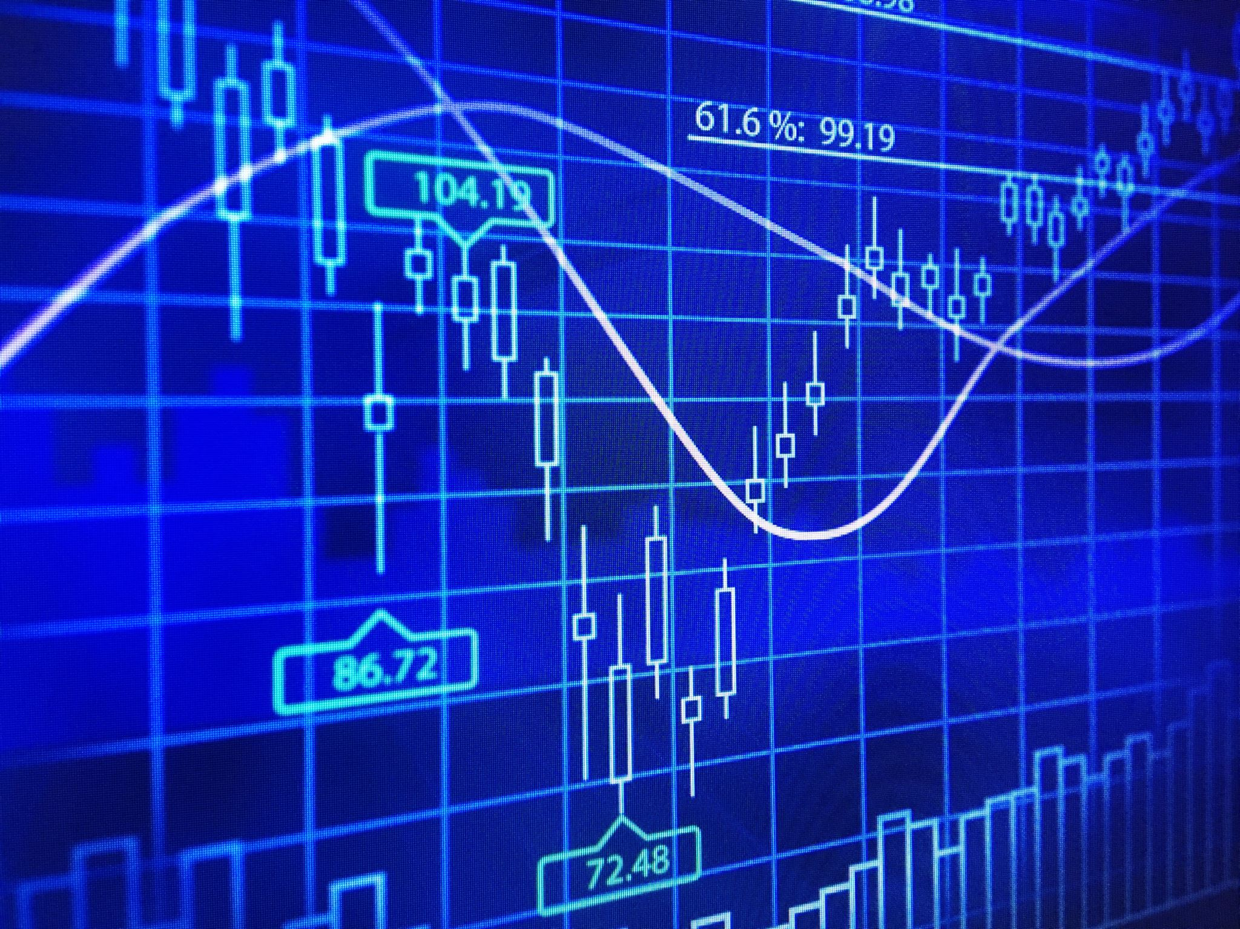
Technical Analysis

Slide 28
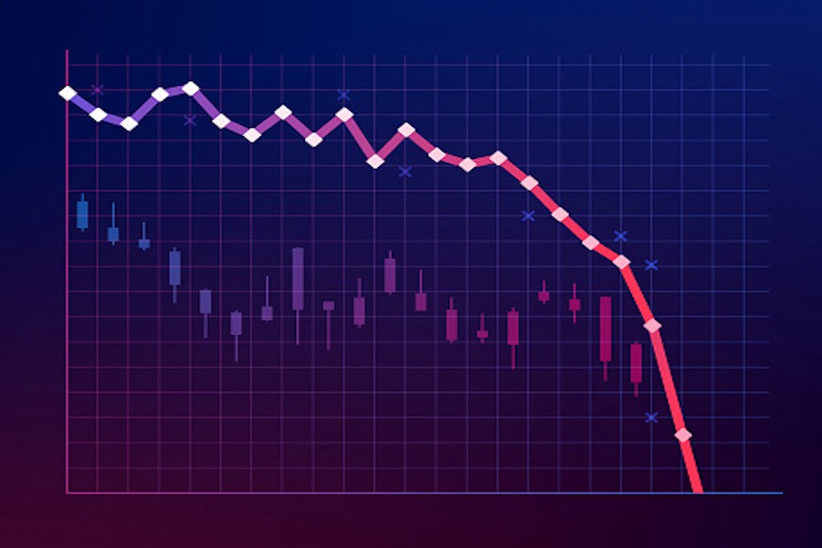
Avoid failure
Methods well known to fail:
Moving Averages (MA, EMA, WMA etc)
MACD
Money Flow
Almost all lagging technical indicators, actually, only work ~50% of the time, which implies they fail every second time(!)
That was a large scale empirical study covering all known TA’s over 20 years(!)

Slide 29
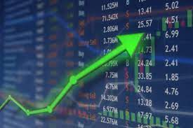
Seek success
Methods known to work:
Candlestick patterns
Pivot Points, Support & resistance
Breakout patterns
Bollinger Bands in some markets

Slide 30
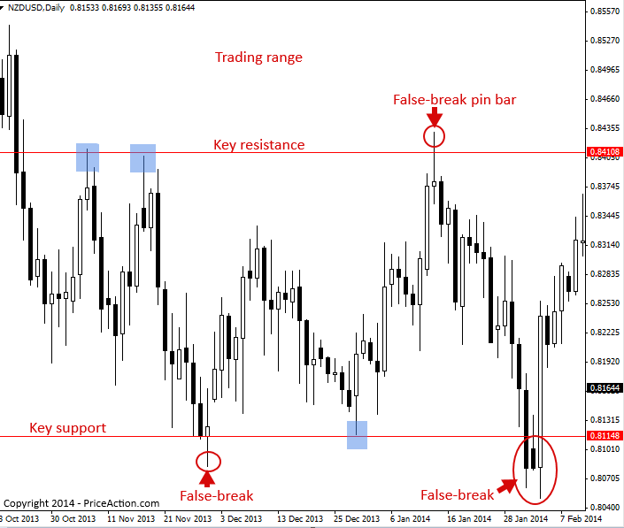
Support / Resistance
Bulk of trading happens within a range
Pivot trading
A pivot, (blue box) happens when the price changes direction and goes back to the opposite key level
Support & resistance needs to be determined per instrument.
Mind the false breakout
Very common in Forex, Crypto and Indices

Slide 31
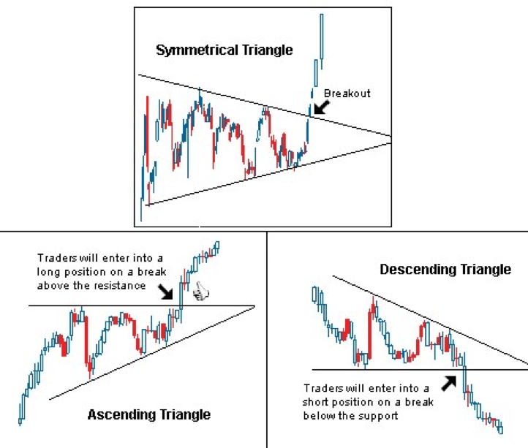
Breakout
Bulk of profit is actually made during breakouts
Breakout means, the price leaves its usual range
Breakouts occur under certain circumstances:
Price above resistance
High trading volume
Clear order delta (Difference between buy & sell)

Slide 32
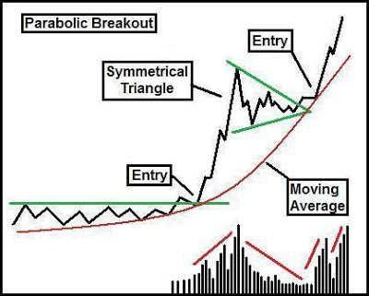
Breakout Patterns
Bulk of profit is actually made during breakouts
Breakout means, the price leaves its usual range
Breakouts occur under certain circumstances:
Price above resistance
High trading volume
Clear order delta (Difference between buy & sell)

Slide 33
Candlestick Patterns
Bulk of profit is actually made during breakouts
Breakout means, the price leaves its usual range
Breakouts occur under certain circumstances:
Price above resistance
High trading volume
Clear order delta (Difference between buy & sell)

Slide 34
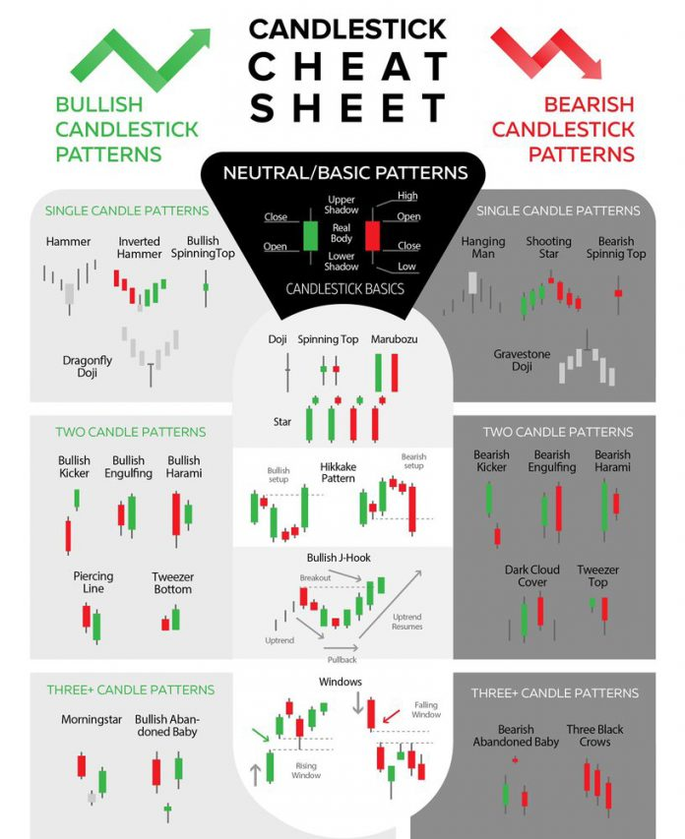
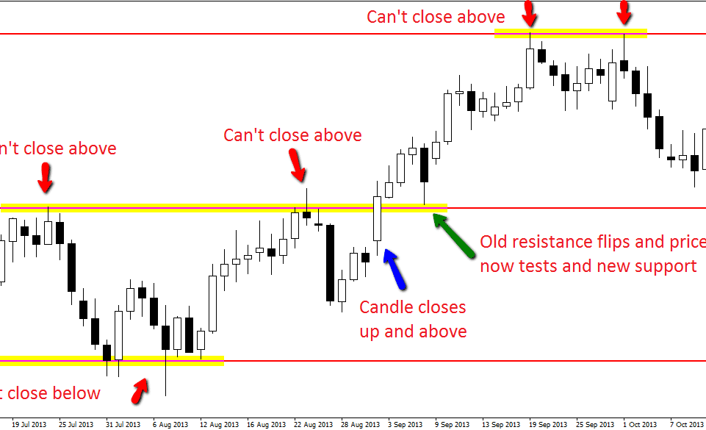






Candlestick patterns, breakouts

Slide 35
Conclusion
Results of swing trading depends on skills
Skill means interpreting the charts correctly, making a proper trade plan, and execute the plan efficiently
However, unlike Buy & Hold, swint trades are harder to hedge especially on short time frames
Important: Always practice on a test account with virtual money. Never ever risk real money you need!
Trading topic will be expanded on the next few meetups

Slide 36
Part II: Crypto Investment

Slide 37


Q & A

Slide 38
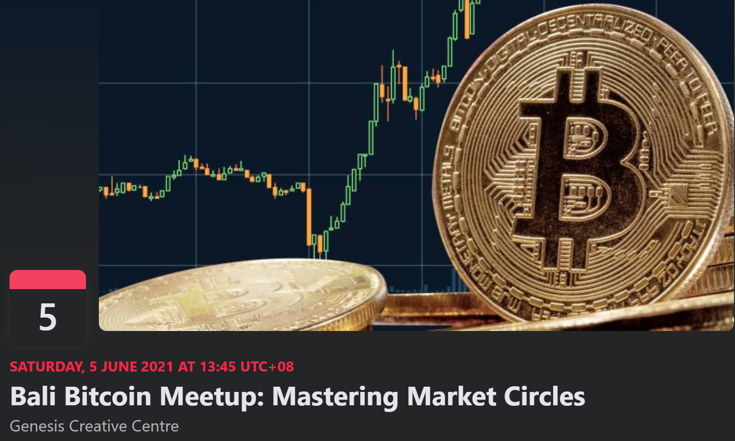
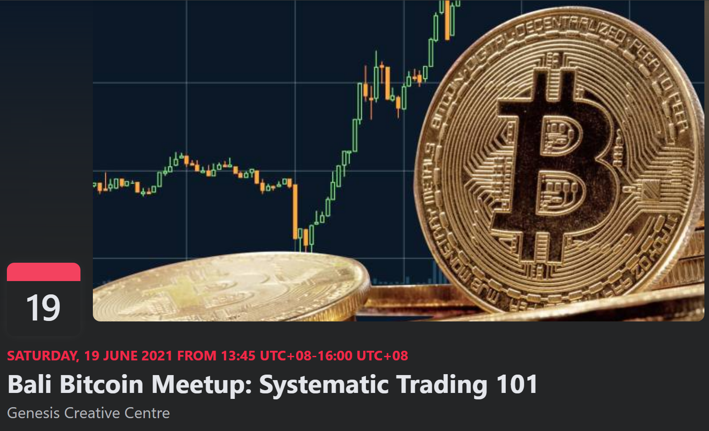
Next Events
June/5: Mastering market circles
June/19: Systematic Trading 101
July/3: Systematic Trading 202

Slide 39




Community
https://t.me/joinchat/2T6yvFcokRQ3ZDQ0
/ Bali Bitcoin

Slide 40


